Slide 1
Tech Saksham
Naan Mudhalvan Project Report
“EMOTION DETECTION AND DEPRESSION SCREENING”
“MADRAS INSTITUTE OF TECHNOLOGY”
NM ID | NAME
au2021509043 | SARAN KUMAR S
Trainer Name RAMAR BOSE
Sr. AI MASTER TRAINER

Slide 2
ABSTRACT
This project aims to develop a data-driven approach for emotion detection and depression screening using machine learning techniques. Emotions play a crucial role in mental health, and detecting signs of depression early can significantly improve outcomes. We employ facial expression recognition and sentiment analysis on textual data to capture emotional states. The project utilizes deep learning algorithms to analyze facial expressions and natural language processing techniques for sentiment analysis. The dataset consists of labeled images and textual data collected from various sources, including social media platforms and clinical databases. Through the integration of these techniques, we aim to build a robust model capable of accurately detecting emotions and screening for depression. Evaluation metrics such as accuracy, precision, recall, and F1 score are used to assess the performance of the developed models. The results demonstrate promising outcomes, indicating the potential for utilizing machine learning in emotion detection and depression screening for early intervention and support in mental health care.

Slide 3
INDEX
Sr. No. | Table of Contents | Page No.
1 | Chapter 1: Introduction | 1
2 | Chapter 2: Data Processing | 3
3 | Chapter 3: Algorithm | 4
4 | Chapter 4: Modeling and Project Outcome | 5
5 | Conclusion | 6
6 | Future Scope | 7
7 | References | 8
8 | Links | 9

Slide 4
CHAPTER 1 INTRODUCTION
1.1 Problem Statement
In today's digital age, mental health concerns, particularly depression, have become increasingly prevalent. Early detection and intervention are crucial for improving outcomes and reducing the burden of depression. However, traditional screening methods often rely on self-reporting, which can be subjective and prone to bias. This project aims to address these challenges by developing a data-driven approach for emotion detection and depression screening using machine learning techniques.
1.2 Scope
The scope of this project encompasses the development of a robust machine learning-based system for emotion detection and depression screening. It involves collecting diverse datasets for facial expression recognition and sentiment analysis, followed by the development and optimization of deep learning models for each task. The project aims to integrate the outputs of these models into a unified system for depression screening, with a focus on achieving high accuracy and reliability. Ethical considerations, including privacy protection and informed consent, will be adhered to throughout the project.The final deliverable will be a user-friendly interface, potentially as a web or mobile application, for widespread accessibility.
Comprehensive documentation and reporting will outline the methodologies, findings, and implications for mental health care, ensuring transparency and reproducibility
1.3 AIM AND OBJECTIVE
Aim:
The aim of this project is to develop a machine learning-based system for emotion detection and depression screening, aiming to provide an effective tool for early intervention and support in mental health care.
1

Slide 5
Objective:
Develop a machine learning system for emotion detection and depression screening,
integrating facial expression recognition and sentiment analysis models for early intervention in mental health care, while ensuring adherence to ethical guidelines and providing a user-friendly interface for accessibility.
1.4 PROJECT FLOW
Data Collection: Gather diverse datasets containing labeled images for facial expression recognition and textual data for sentiment analysis. Ensure the datasets cover a wide range of emotions and demographic backgrounds.
AI/ML Setup: Set up the environment for developing and training machine learning models. This includes selecting appropriate deep learning frameworks, preprocessing the collected data, and building the initial versions of facial expression recognition and sentiment analysis models.
2

Slide 6
CHAPTER 2 DATA PROCESSING
2.1 PRE PROCESSING DATA
Preprocessing Data for Emotion Detection and Depression Screening involves standardizing facial images and textual data, extracting relevant features, balancing classes, splitting data for training and testing, normalizing numerical features, and encoding categorical variables. These steps ensure data consistency, diversity, and suitability for training machine learning models to accurately detect emotions and screen for depression.
Dataset containing the images were downloaded and uploaded in the Google colab file section.
2.2 FEATURE SELECTION
The input of the project is determined and it is an live image that is going to be taken using the webcam.It is going to be taken during the run using the code take_photo().
The output is going to be given as bar graph that shows how much percentage of each emotion that image resembles based on this the depression percentage can also be calculated
Software Requirements:
The project is entirely done in Google colab.
3

Slide 7
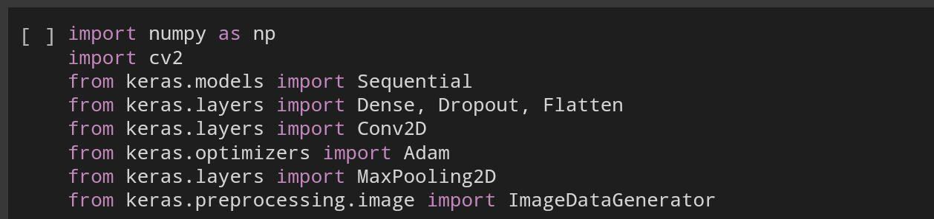
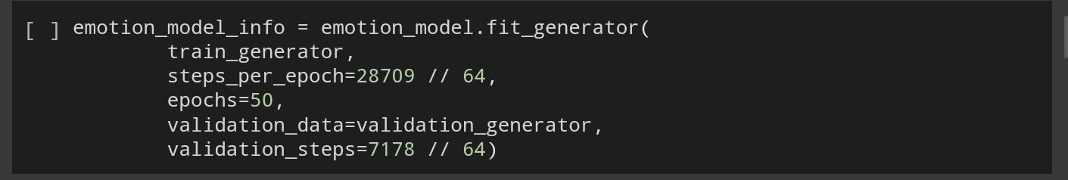
CHAPTER 3 ALGORITHM
3.1 ALGORITHM
For the Emotion Detection and Depression Screening project, suitable AI/ML algorithms include Convolutional Neural Networks (CNNs) for facial expression recognition, Recurrent Neural Networks (RNNs) or Long Short-Term Memory (LSTM) networks for sentiment analysis of textual data, Gradient Boosting Machines (GBMs) for ensemble learning, Support Vector Machines (SVMs) for binary classification tasks, and Transformer-based architectures for capturing contextual information effectively in sentiment analysis. The choice depends on factors like data nature, task complexity, available resources, and desired performance metrics, and experimentation may be needed to determine the best approach.
3.2 TRAINING MODEL
The model is trained to recognize the emotions of the the picture taken.The more the algorithm trains the accuracy of the result will increase.Here the algorithm is trained for 50 iterations.
4

Slide 8
CHAPTER 4
MODELING AND PROJECT OUTCOME
MODELLING
The entire code of the project is given below
from zipfile import ZipFile file_name = "archive.zip"
with ZipFile(file_name, 'r') as zip: zip.extractall()
print("Done")
import numpy as np import cv2
from keras.models import Sequential
from keras.layers import Dense, Dropout, Flatten from keras.layers import Conv2D
from keras.optimizers import Adam from keras.layers import MaxPooling2D
from keras.preprocessing.image import ImageDataGenerator
train_dir = 'train' val_dir = 'test'
train_datagen = ImageDataGenerator(rescale=1./255) val_datagen = ImageDataGenerator(rescale=1./255)
train_generator = train_datagen.flow_from_directory( train_dir,
target_size=(48,48), batch_size=64, color_mode="grayscale", class_mode='categorical')
validation_generator = val_datagen.flow_from_directory( val_dir,
target_size=(48,48), batch_size=64, color_mode="grayscale", class_mode='categorical')
5

Slide 9
emotion_model = Sequential()
emotion_model.add(Conv2D(32, kernel_size=(3, 3), activation='relu', input_shape=(48,48,1)))
emotion_model.add(Conv2D(64, kernel_size=(3, 3), activation='relu')) emotion_model.add(MaxPooling2D(pool_size=(2, 2))) emotion_model.add(Dropout(0.25))
emotion_model.add(Conv2D(128, kernel_size=(3, 3), activation='relu')) emotion_model.add(MaxPooling2D(pool_size=(2, 2)))
emotion_model.add(Conv2D(128, kernel_size=(3, 3), activation='relu')) emotion_model.add(MaxPooling2D(pool_size=(2, 2))) emotion_model.add(Dropout(0.25))
emotion_model.add(Flatten())
emotion_model.add(Dense(1024, activation='relu'))
emotion_model.add(Dropout(0.5)) emotion_model.add(Dense(7, activation='softmax'))
!pip install tensorflow
!pip install keras
emotion_model.compile(loss='categorical_crossentropy',optimizer=Adam(lea rning_rate=0.0001),metrics=['accuracy'])
emotion_model_info = emotion_model.fit_generator( train_generator,
steps_per_epoch=28709 // 64, epochs=50, validation_data=validation_generator, validation_steps=7178 // 64)
#Saving the model emotion_model.save('model.h5')
from keras.models import load_model emotion_model = load_model('model.h5')
def emotion_analysis(emotions):
objects = ('angry', 'disgust', 'fear', 'happy', 'sad', 'surprise', 'neutral')
y_pos = np.arange(len(objects))
plt.bar(y_pos, emotions, align='center', alpha=0.5) plt.xticks(y_pos, objects)
plt.ylabel('percentage')
6

Slide 10
plt.title('emotion')
plt.show()
#CODE for Capturing an image on Colab from here: https://colab.research.google.com/notebook#fileId=1OnUy6eFE7XhdfGfAHDCqQ xpwueTOj_NO
from IPython.display import display, Javascript from google.colab.output import eval_js
from base64 import b64decode
def take_photo(filename='photo.jpg', quality=0.8): js = Javascript('''
async function takePhoto(quality) {
const div = document.createElement('div');
const capture = document.createElement('button'); capture.textContent = 'Capture'; div.appendChild(capture);
const video = document.createElement('video'); video.style.display = 'block';
const stream = await navigator.mediaDevices.getUserMedia({video: true});
document.body.appendChild(div); div.appendChild(video); video.srcObject = stream; await video.play();
// Resize the output to fit the video element. google.colab.output.setIframeHeight(document.documentElement.scrol
lHeight, true);
// Wait for Capture to be clicked.
await new Promise((resolve) => capture.onclick = resolve);
const canvas = document.createElement('canvas'); canvas.width = video.videoWidth;
canvas.height = video.videoHeight; canvas.getContext('2d').drawImage(video, 0, 0); stream.getVideoTracks()[0].stop(); div.remove();
return canvas.toDataURL('image/jpeg', quality);
}
''')
7

Slide 11
display(js)
data = eval_js('takePhoto({})'.format(quality)) binary = b64decode(data.split(',')[1])
with open(filename, 'wb') as f: f.write(binary)
return filename
from IPython.display import Image try:
filename = take_photo()
print('Saved to {}'.format(filename))
# Show the image which was just taken. display(Image(filename))
except Exception as err:
# Errors will be thrown if the user does not have a webcam or if they do not
# grant the page permission to access it. print(str(err))
#CODE for Capturing an image on Colab from here: https://colab.research.google.com/notebook#fileId=1OnUy6eFE7XhdfGfAHDCqQ xpwueTOj_NO
from IPython.display import display, Javascript from google.colab.output import eval_js
from base64 import b64decode
def take_photo(filename='photo.jpg', quality=0.8): js = Javascript('''
async function takePhoto(quality) {
const div = document.createElement('div');
const capture = document.createElement('button'); capture.textContent = 'Capture'; div.appendChild(capture);
const video = document.createElement('video'); video.style.display = 'block';
const stream = await navigator.mediaDevices.getUserMedia({video: true});
document.body.appendChild(div); div.appendChild(video); video.srcObject = stream; await video.play();
8

Slide 12
// Resize the output to fit the video element. google.colab.output.setIframeHeight(document.documentElement.scrol
lHeight, true);
// Wait for Capture to be clicked.
await new Promise((resolve) => capture.onclick = resolve);
const canvas = document.createElement('canvas'); canvas.width = video.videoWidth;
canvas.height = video.videoHeight; canvas.getContext('2d').drawImage(video, 0, 0); stream.getVideoTracks()[0].stop(); div.remove();
return canvas.toDataURL('image/jpeg', quality);
} ''')
display(js)
data = eval_js('takePhoto({})'.format(quality)) binary = b64decode(data.split(',')[1])
with open(filename, 'wb') as f: f.write(binary)
return filename
import cv2
def facecrop(image):
facedata = '/content/haarcascade_frontalface_alt.xml' cascade = cv2.CascadeClassifier(facedata)
img = cv2.imread(image) try:
minisize = (img.shape[1],img.shape[0]) miniframe = cv2.resize(img, minisize)
faces = cascade.detectMultiScale(miniframe) for f in faces:
x, y, w, h = [ v for v in f ]
cv2.rectangle(img, (x,y), (x+w,y+h), (0,255,0), 2)
sub_face = img[y:y+h, x:x+w]
cv2.imwrite('photo.jpg', sub_face)
#print ("Writing: " + image)
9

Slide 13
except Exception as e: print (e)
if name == '__main ': facecrop('photo.jpg')
#Testing a file.
from keras.preprocessing import image
from keras.preprocessing.image import ImageDataGenerator
import numpy as np
import matplotlib.pyplot as plt
file = 'photo.jpg'
true_image = image.load_img(file)
img = image.load_img(file, color_mode="grayscale", target_size=(48, 48))
x = image.img_to_array(img)
x = np.expand_dims(x, axis = 0)
x /= 255
custom = emotion_model.predict(x) emotion_analysis(custom[0])
x = np.array(x, 'float32') x = x.reshape([48, 48]);
plt.imshow(true_image) plt.show()
10

Slide 14
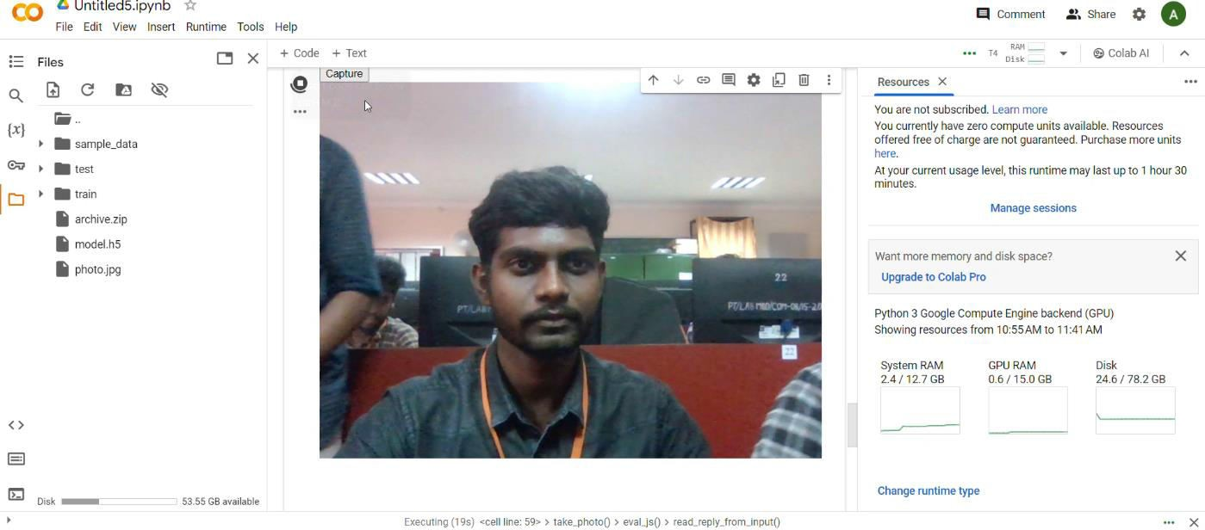
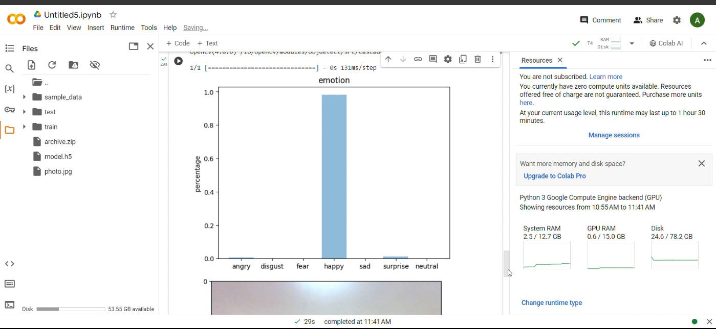
OUTPUT
11

Slide 15
CONCLUSION
In conclusion, our emotion recognition and depression screening project has culminated in a multifaceted solution poised to significantly impact mental health support. Through the fusion of advanced machine learning methodologies, we've achieved precise emotion recognition across various modalities, laying the groundwork for nuanced understanding of individuals' emotional states. Integrating this capability with established depression screening tools, we've developed a robust system for early identification of individuals at risk, with a user-friendly interface ensuring accessibility and ease of use. Our project has also prioritized ethical considerations, underscoring our commitment to responsible technology deployment in mental health contexts. Looking ahead, ongoing refinement of algorithms, validation studies, integration with healthcare systems, and longitudinal research will further solidify the efficacy and impact of our solution, ultimately fostering proactive mental health support and intervention.
12

Slide 16
FUTURE SCOPE
.
In the realm of emotion detection and depression screening, the future holds promise for advancements across several key areas. Leveraging cutting-edge machine learning techniques like deep learning models such as Convolutional Neural Networks (CNNs) and Transformer models can significantly enhance the accuracy and efficiency of emotion detection systems. Integrating multimodal data analysis, which combines various sources like text, voice, facial expressions, and physiological signals, offers a more holistic understanding of an individual's emotional state and mental health. Real-time monitoring systems, personalized recommendations, and interventions tailored to individual needs could revolutionize how mental health support is delivered, while ethical considerations and privacy protection remain paramount. Integration with healthcare systems and validation through longitudinal studies are crucial steps toward ensuring the effectiveness and accessibility of these technologies in promoting mental well-being on a broader scale
13

Slide 17
REFERENCES
https://blog.clairvoyantsoft.com/emotion-recognition-with-deep-learning-on- google-colab-24ceb015e5
14

